Slide 1
N1Health Data Challenge
By: Divya Kopalle

Slide 2
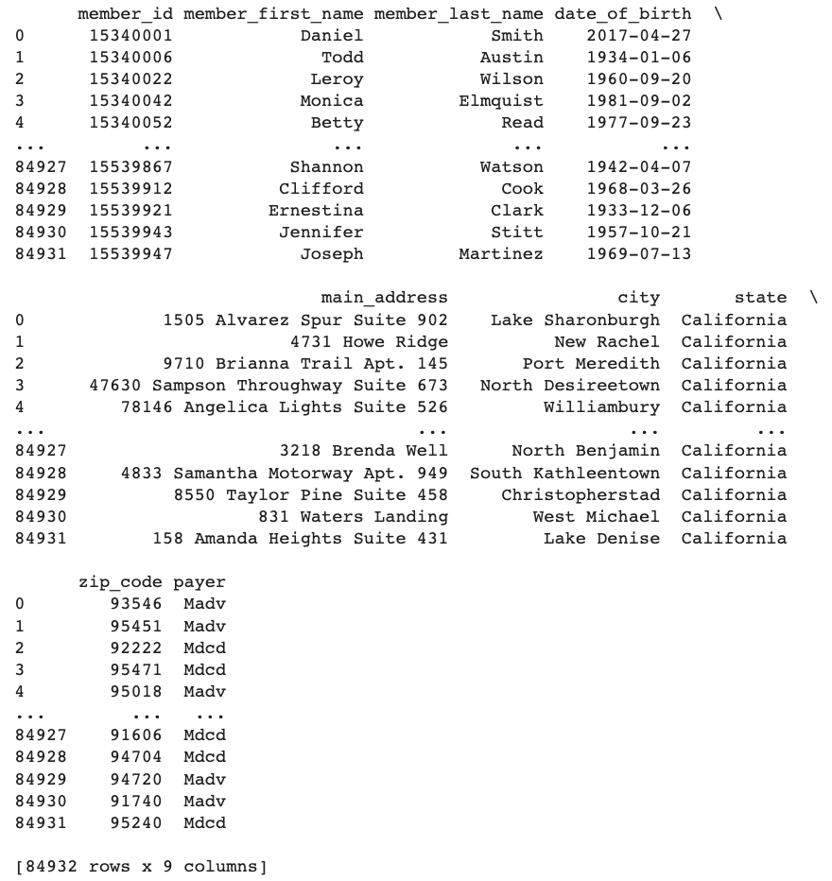
Aggregating & Standardizing Data
Standardize date of birth format to YYYY-MM-DD for all rosters
Use ‘UNION ALL’ to combine rosters
For each roaster select desired columns, specify new columns names, and filter by eligibility date

Slide 3
Summary Statistics
Distinct members eligible in April 2022 | 71,157 members
Number of duplicate members listed | 13,775 members
Breakdown of members by payer | MADV – 31,878 members - 37.5% MDCDC – 53,054 members - 62.5%
Number of members who live in a zip code with a food access score lower than 2 | 6,608 members
Average social isolation score for members: | 3.064
Members who live in the zip code with highest algorex_sdoh_composite_score | [('15404143',), ('15418054',), ('15537550',), ('15391076',), ('15363143',), ('15375855',), ('15456560',), ('15462579',), ('15340102',), ('15346807',), ('15389381',), ('15414827',), ('15482255',), ('15484216',), ('15486908',), ('15489640',), ('15514403',), ('15532243',), ('15539805',), ('15359217',), ('15447186',), ('15487938',), ('15493624',), ('15497844',), ('15506131',), ('15387928',), ('15389759',), ('15403845',), ('15417526',), ('15459547',), ('15495072',), ('15499581',), ('15525968',), ('15363143',), ('15375855',), ('15456560',), ('15340102',), ('15346807',), ('15389381',), ('15482255',), ('15484216',), ('15486908',), ('15489640',)]

Slide 4
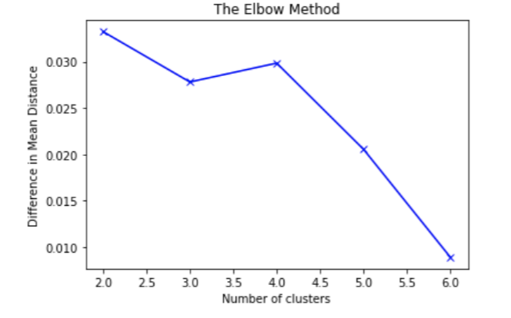
Cluster Analysis
Determine optimal number of clusters
Run K-means analysis on data

Slide 5
Cluster Analysis
Mean scores per cluster
Cluster 1 - 47 % of members
neighborhood_stress_score 0.265307
social_isolation_score 3.330170
transportation_access_score 4.309297
food_access_score 3.525602
unstable_housing_score 3.022741
state_govt_assistance 0.768979
homeless_indicator 7.058801
Create separate data frames for members in each cluster
Cluster 2 - 47% of members
neighborhood_stress_score -0.491657
social_isolation_score 2.630329
transportation_access_score 4.143515
food_access_score 2.784939
unstable_housing_score 1.875563
state_govt_assistance 0.338415
homeless_indicator 7.339112
Find mean of each column for each cluster
Cluster 3 - 6% of members
neighborhood_stress_score 0.702471
social_isolation_score 4.333782
transportation_access_score 4.400072
food_access_score 3.285652
unstable_housing_score 5.344900
state_govt_assistance 1.084788
homeless_indicator 6.745485

Slide 6
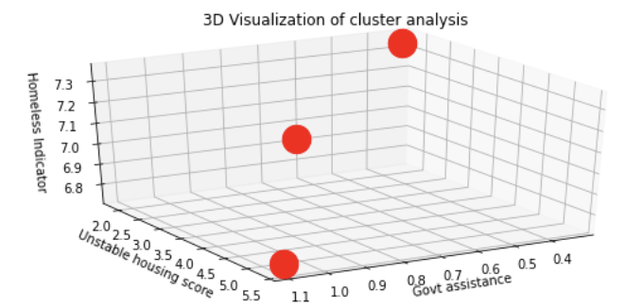
Neighborhoods with low govt assistance and unstable housing are still struggling with homelessness
lowest govt assistance, low unstable housing, highest homeless indicator
medium govt assistance, low unstable housing, medium homeless indicator
C2
C1
C3
high govt assistance, high unstable housing, lowest homeless indicator

Slide 7
Thank you!

